Slide 1
SMART RESUME SELECTOR
MOHAMMED ADHEEB P
MES20MCA-2025
PRODUCT OWNER- VASUDEVAN T V

Slide 2
TABLE OF CONTENTS
Introduction
Modules
Data Flow Diagram
Table Design
Developing Environment
Product Backlog
User Stories
Project Plan
Sprint Plans
Sprint Actual

Slide 3
INTRODUCTION
Job is an important phase of a person’s life as it brings out the true personality and tests you in pressure handling situations. It is often seen that the correct person is not placed for the position and later organization find that the selected employee does not have the required skills and qualification which results in dissatisfaction with employee. Every time user looks for a job it will show a lot of job suggestions and most of them are not a good job for the user it will definitely confuses the user. In this project we suggest jobs for users that are perfectly matches with user requirements.

Slide 4
MODULES
Admin
Login.
Approve Company.
View Companies.
View Candidates.
View Feedback.
Block and Unblock Company.
Company
Registration.
Login.
Add Vacancies.
View Applications.
Update Status.
Feedback.
Candidate
Registration.
Login.
View Company.
View Vacancies.
View Recommendation.
Apply for Vacancy.
Feedback.

Slide 5
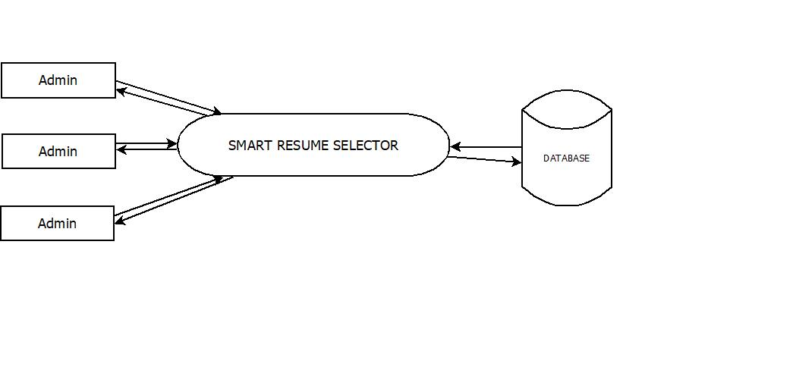
DFD
Level 0

Slide 6
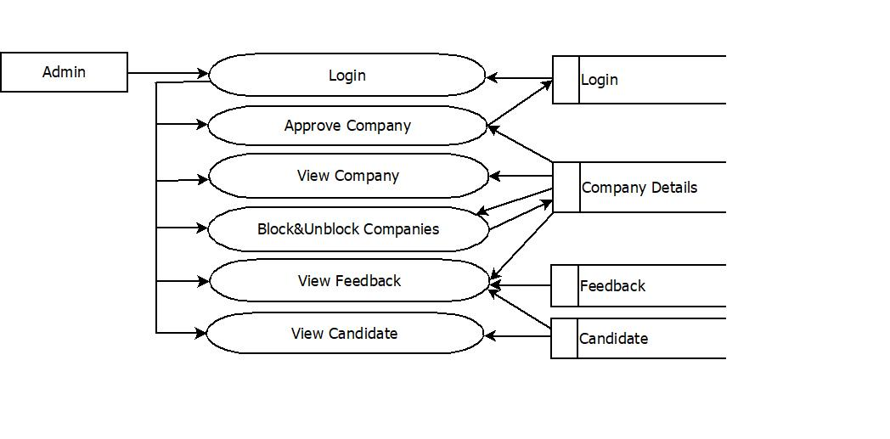
Level 1.1

Slide 7
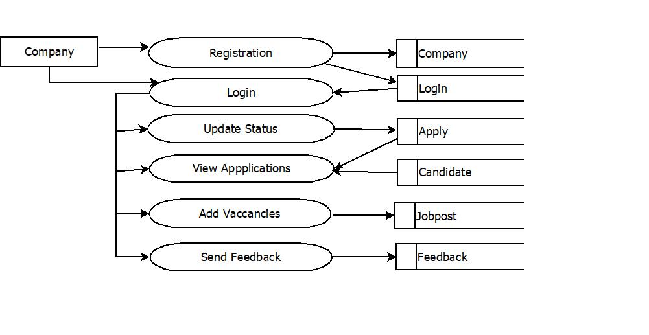
Level 1.2

Slide 8
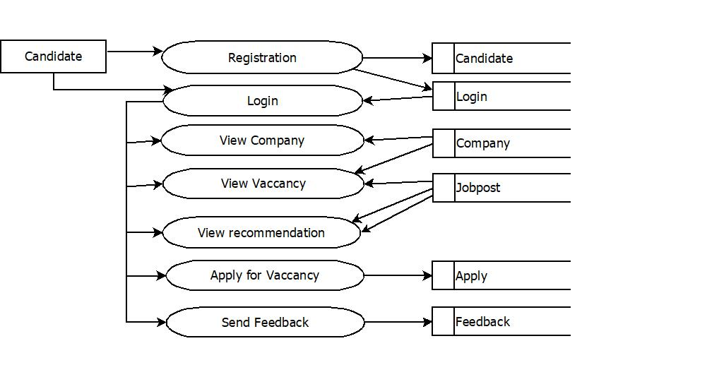
Level 1.3

Slide 9
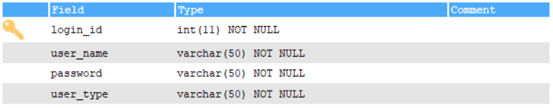
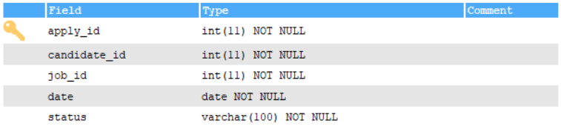
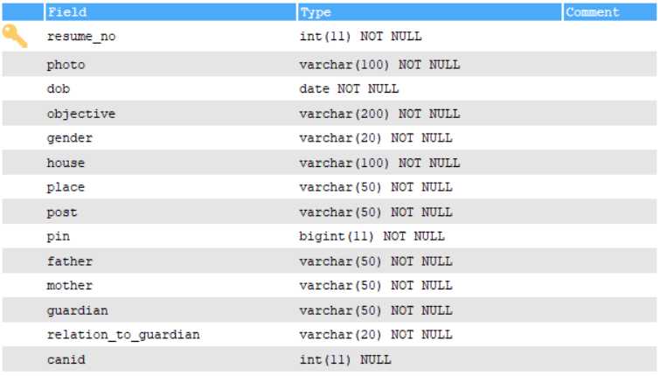
Table Design

Slide 10
DEVELOPING ENVIRONMENT
Hardware Requirements
Input Device : Mouse, Keyboard
Output Device : Monitor
Memory : 4 Gb Ram(Minimum)
Processor : Intel core i3 or above
Software Requirements
Operating System : Windows 8 /10 for Better Performance
Front End : HTML, CSS, Javascript
Back End : Mysql, Python (Flask)
Software Used : Pycharm

Slide 11
PRODUCT BACKLOG

Slide 12
User Story ID | Priority <High/Medium/Low> | Size (Hours) | Sprint <#> | Status <Planned/In progress/Completed> | Release Date | Release Goal
1 | Medium | 2 | 1 | Completed |  | Table design
2 | High | 3 |  | Completed |  | Form design
3 | High | 5 |  | Completed |  | Basic coding
3 | High | 5 | 2 | Planned |  | Automatic occupational category classification
4 | Medium | 5 |  | Planned |  | Sorting vacancies based on the qualification.
5 | High | 5 | 3 | Planned |  | Select best vacancies based on the qualification.
6 | medium | 5
7 | Medium | 5 | 4 | Planned |  | Section based scoring
8 | High | 5 |  | Planned |  | Ranking of vacancies based on score.

Slide 13
USER STORIES
User StoryID | As a <type of user> | I want to | So that I can
1 | Admin | login | login successful with correct username and password
2 | Admin | Accept company | view registered companies and accept or decline company
3 | Admin | View accepted company | view accepted companies
4
5
6
7
8
9
10
11
12
13
14
15
16
17

Slide 14
PROJECT PLAN
User story ID | Task name | Start date | End date | Days | Status
Sprint1
1 | UI designing | 30/11/2021 | 02/12/2021 | 3 | Completed
2 | Database connectivity | 10/12/2021 | 12/12/2021 | 2 | Completed
3 | Coding | 22/11/2021 | 27/12/2021 | 5 | Completed
Sprint2
4 | UI designing | 28/12/2022 | 31/01/2022 | 3 | In progress
5 | Database connectivity | 1/01/2022 | 4/01/2022 | 3 | In progress
6 | Coding | 15/01/2022 | 21/01/2022 | 6 | In progress

Slide 15
User story ID | Task name | Start date | End date | Days | Status
Sprint3
7 | UI designing | 05/02/2022 | 07/02/2022 | 2 | In progress
8 | Database connectivity | 09/02/2022 | 10/02/2022 | 1 | In progress
9 | Coding | 12/02/2022 | 15/02/2022 | 3 | In progress
10 | Testing & validation | 16/02/2022 | 20/02/2022 | 4 | In progress
Sprint4
11 | UI designing | 21/02/2022 | 23/02/2022 | 2 | In progress
12 | Database connectivity | 24/02/2022 | 25/02/2022 | 1 | In progress
13 | Coding | 26/02/2022 | 28/02/2022 | 2 | In progress

Slide 16
SPRINT BACKLOG PLAN
Backlog Item | Status & completion date | Original estimate in hours | Day1 | Day2 | Day3 | Day4 | Day5 | Day6 | Day7 | Day8 | Day9 | Day10 | Day11 | Day12 | Day13 | Day14
User story #1 |  | hrs | hrs | hrs | hrs | hrs | hrs | hrs | hrs | hrs | hrs | hrs | hrs | hrs | hrs | hrs
UI designing | 18/12/2021 | 3 | 1 | 1 | 1 | 0 | 0 | 0 | 0 | 0 | 0 | 0 | 0 | 0 | 0 | 0
Database connectivity | 24/12/2021 | 2 | 1 | 1 | 0 | 0 | 0 | 0 | 0 | 0 | 0 | 0 | 0 | 0 | 0 | 0
Coding | 08/01/2022 | 5 | 1 | 0 | 2 | 1 | 1 | 0 | 0 | 0 | 0 | 0 | 0 | 0 | 0 | 0
Testing
User story #2
UI designing
Database connectivity
Coding
Testing

Slide 17
SPRINT ACTUAL
Backlog Item | Status & completion date | Original estimate in hours | Day1 | Day2 | Day3 | Day4 | Day5 | Day6 | Day7 | Day8 | Day9 | Day10 | Day11 | Day12 | Day13 | Day14
User story #1 |  | hrs | hrs | hrs | hrs | hrs | hrs | hrs | hrs | hrs | hrs | hrs | hrs | hrs | hrs | hrs
UI designing | 18/12/2021 | 3 | 1 | 1 | 1 | 0 | 0 | 0 | 0 | 0 | 0 | 0 | 0 | 0 | 0 | 0
Database connectivity | 24/12/2021 | 2 | 1 | 1 | 0 | 0 | 0 | 0 | 0 | 0 | 0 | 0 | 0 | 0 | 0 | 0
Coding | 08/01/2022 | 5 | 1 | 0 | 2 | 1 | 1 | 0 | 0 | 0 | 0 | 0 | 0 | 0 | 0 | 0
Testing
User story #2
UI designing
Database connectivity
Coding
Testing

